Slide 1
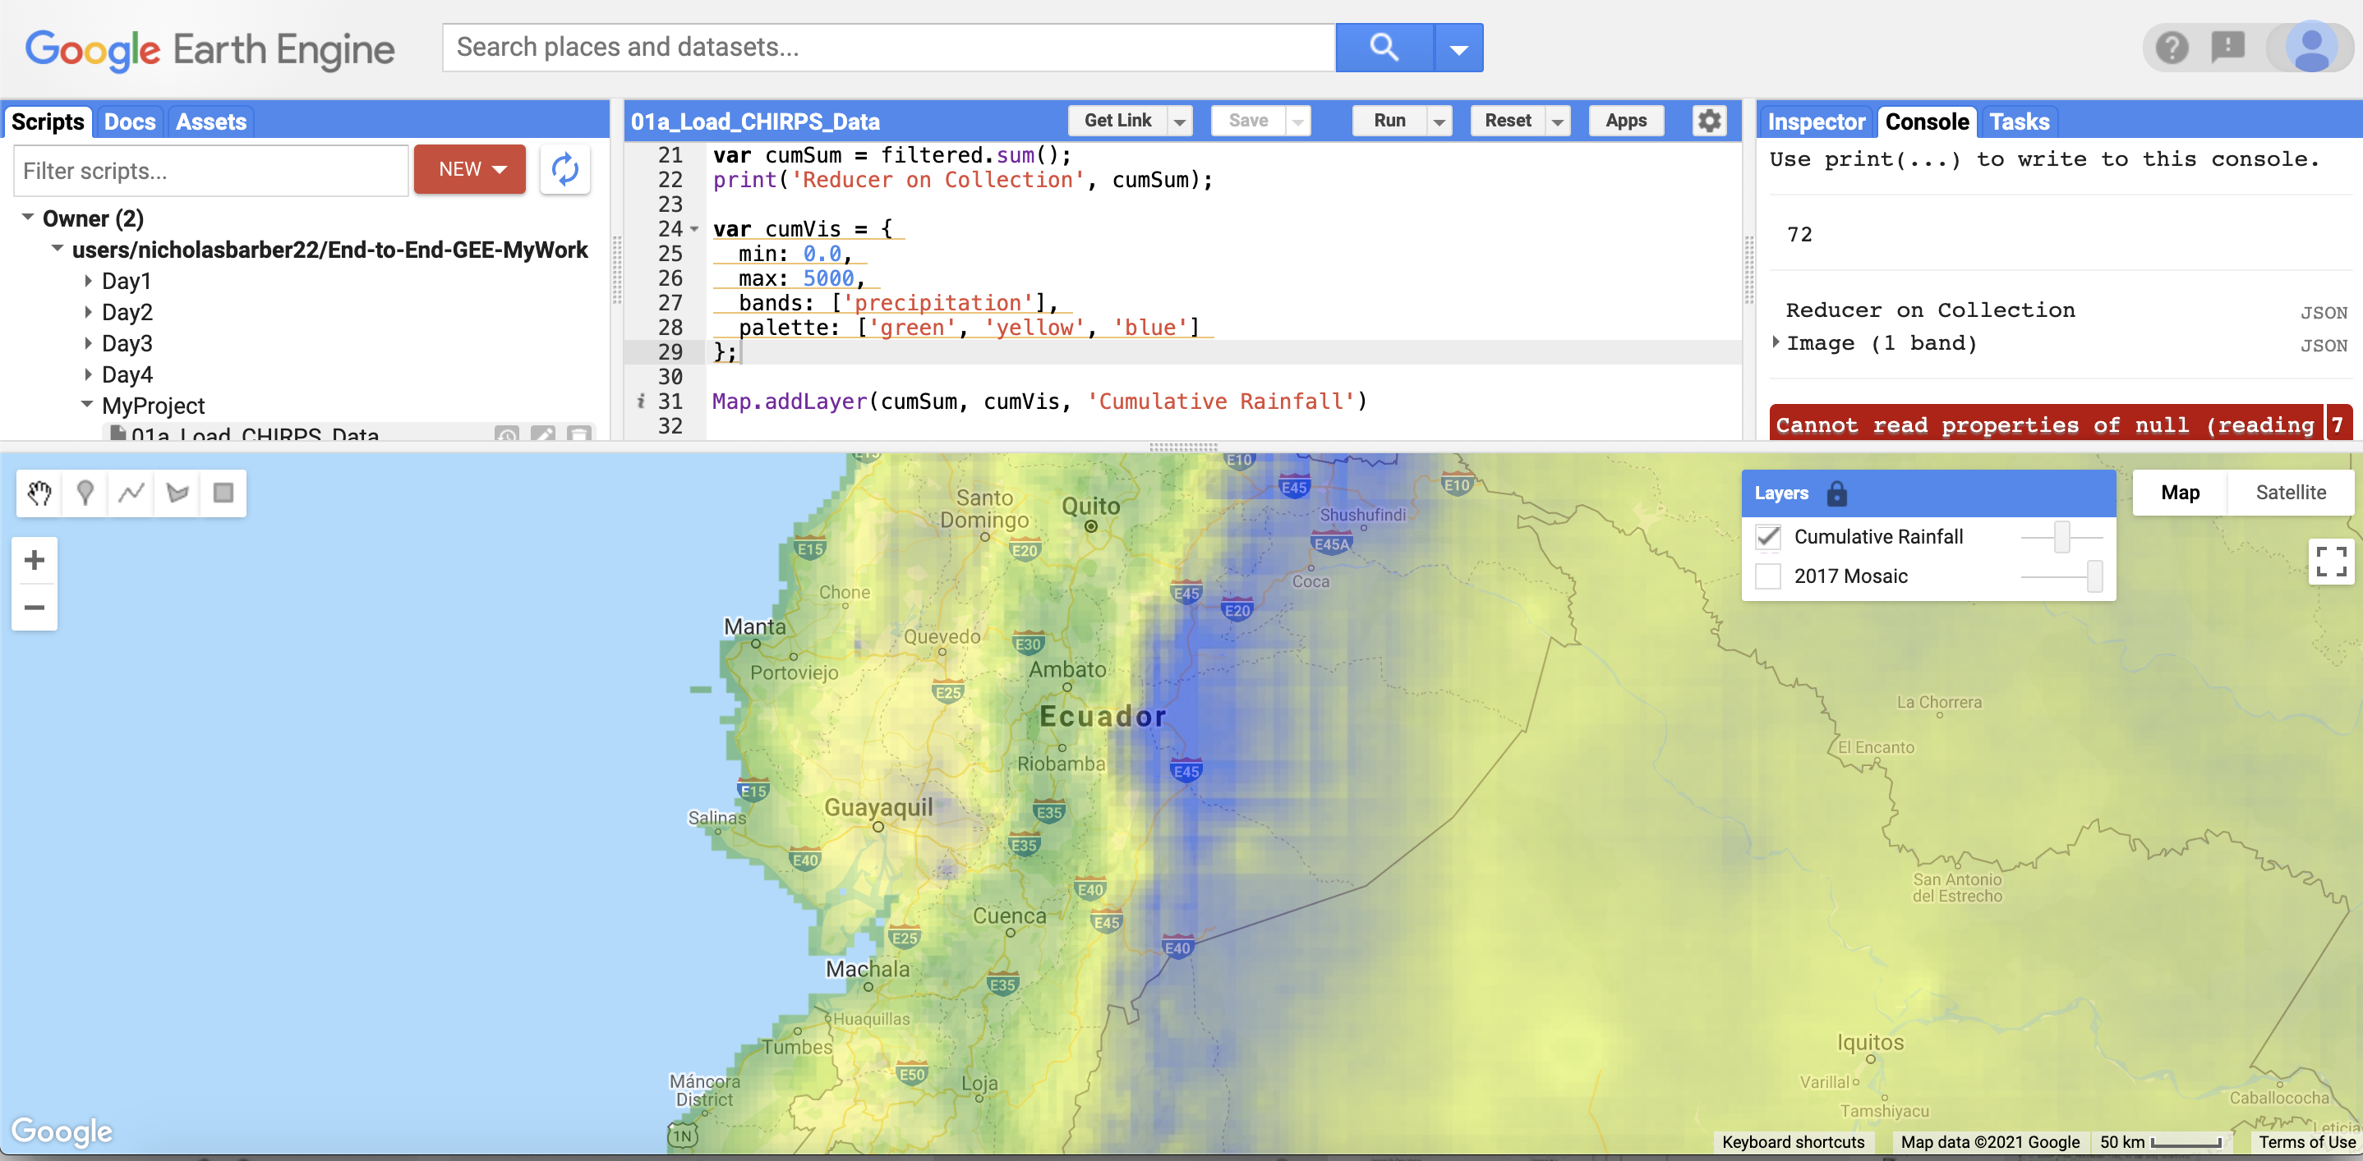

GIS for Geoscientists Session 4: Advanced GIS
Presented by Nicholas Barber, 4th Year PhD Student at the University of Cambridge, U.K.
ndb38@cam.ac.uk | www.volcannick.com | https://github.com/ndb38 | Twitter @volcannick

Slide 2
Course Outline
Friday October 29th:– Principles for using GIS in the Geosciences
Course Objectives
Principles of GIS
Tour of the Interface
Friday November 5th: Beginner GIS Exercises
Guagua Pichincha Hazard Assessment
Projections + Data Types
Managing Layers, Manipulating Data, Designing Your Map
Tuesday November 16th: Intermediate GIS Exercises
Getting more out of GIS
Geoprocessing, Spatial Analysis, Data Management, Advanced formatting, Geostatistics
Friday November 26th: Advanced GIS
Peak into Advanced GIS
Custom Actions , Model Builder, Python, Google Earth Engine, Databases
Final map assessment due (if you want feedback) by 31/11/21

Slide 3
New Supplementary Lectures!
Supplementary Lecture #5: Exercise #1 Part 1
Data import, manipulation, and analysis
Supplementary Lecture #6: Exercise #1 Part 2
Layer symbology, Layout Manager, Designing a Map
You can find these on Youtube!

Slide 4
Reminder: apply a Critical GIS Lens
How do we as geoscientists use maps?
What is the goal of making a map?
How do we access data?
Whose permission do we have to use that data?
What decisions do we make when we design a map that perpetuate inequity?
How do we ensure the results of our science have a positive impact on the people concerned?

Slide 5
Finishing Up From Session 3:
Exercise #3: Landslide Risk
Importing precipitation data
Calculating Raster Slope
Rasterize rainfall
Use raster calculator
Advanced Formatting/Symbology
Line Symbology
Draw Effects
Heatmaps
Raster Viz.
3D Viewer

Slide 6
Advanced Material
Database Connections | Model Builder | Python | Google Earth Engine

Slide 7
What do we mean by “Advanced”
Advanced GIS users concern themselves with a few key problems
Automation: How can I make my computer work for me as I run complex chains of spatial analyses? How do I save myself time?
Reproducibility: How do I replicate the same series of analyses in multiple projects? How do I ensure other people can reproduce my analyses?
Complexity: How do perform multi-staged, conceptually difficult spatial tasks over hundreds to thousands of features?
Visualizations: How do we provide insightful and beautiful visualizations of our spatial data?

Slide 8
Accessing data not on your hard drive
Something I’ve kept from you until now: you don’t always have to download data directly to your machine!
Some GIS files are so common, desirable, or large, it’s not practical to distribute them as downloads
Instead, you can use QGIS’ inbuilt database connections to access remotely-stored datasets
Two use cases that may be relevant in this case:
1) What if all you want is a “basemap” to show the local context of your samples? For example, what if you want to show your points set against a Google Satellite background?
2) You are doing field work in Scotland, and you want a basemap showing the geology of the Scottish Isles set as a backdrop for your work. However, when you go to look on government website’s, they don’t offer a download! How are you supposed to get this basemap?
Answer to both questions: Database connections!

Slide 9
1. Database Connections
XYZ Tiles
Basemaps
WMS
Remote data providers (BGS, USGS, etc.).
WFS
Smithsonian
Difference between WFS and WMS?
WMS imports a map whose underlying features aren’t available for querying
WFS imports features the user can manipulate

Slide 10
2. The Graphical Modeler
When working with a GIS, analytical steps are part of a chain of methods, and these methods aren’t always reproducible. Think about how I’ve taught you up to this point!
Using the graphical modeler, you can wrap chains of operations into a single process, making it convenient to execute later with a different set of inputs, or making it possible to reproduce your method in a different area.
The model you make is executed as a single “tool” in the Processing toolbox, making execution fast and efficient
Spatial indexing!
Our task: Make our Exercise #1 analysis reproducible
Citation: https://docs.qgis.org/3.22/en/docs/user_manual/processing/modeler.html

Slide 11

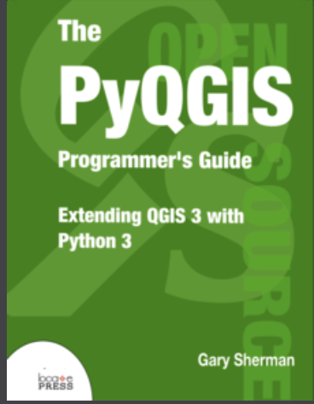
3. Python in QGIS
Can use Python natively in QGIS!
QGIS is actually built on Python
Uses own PyQGIS library with challenging, but accessible, syntax
https://docs.qgis.org/testing/en/docs/pyqgis_developer_cookbook/
Why might we do this?
Automate tasks
Make GIS analyses reproducible
Create your own plugin
Integrate GIS into our regular programming workflow
https://anitagraser.com/pyqgis-101-introduction-to-qgis-python-programming-for-non-programmers/

Slide 12

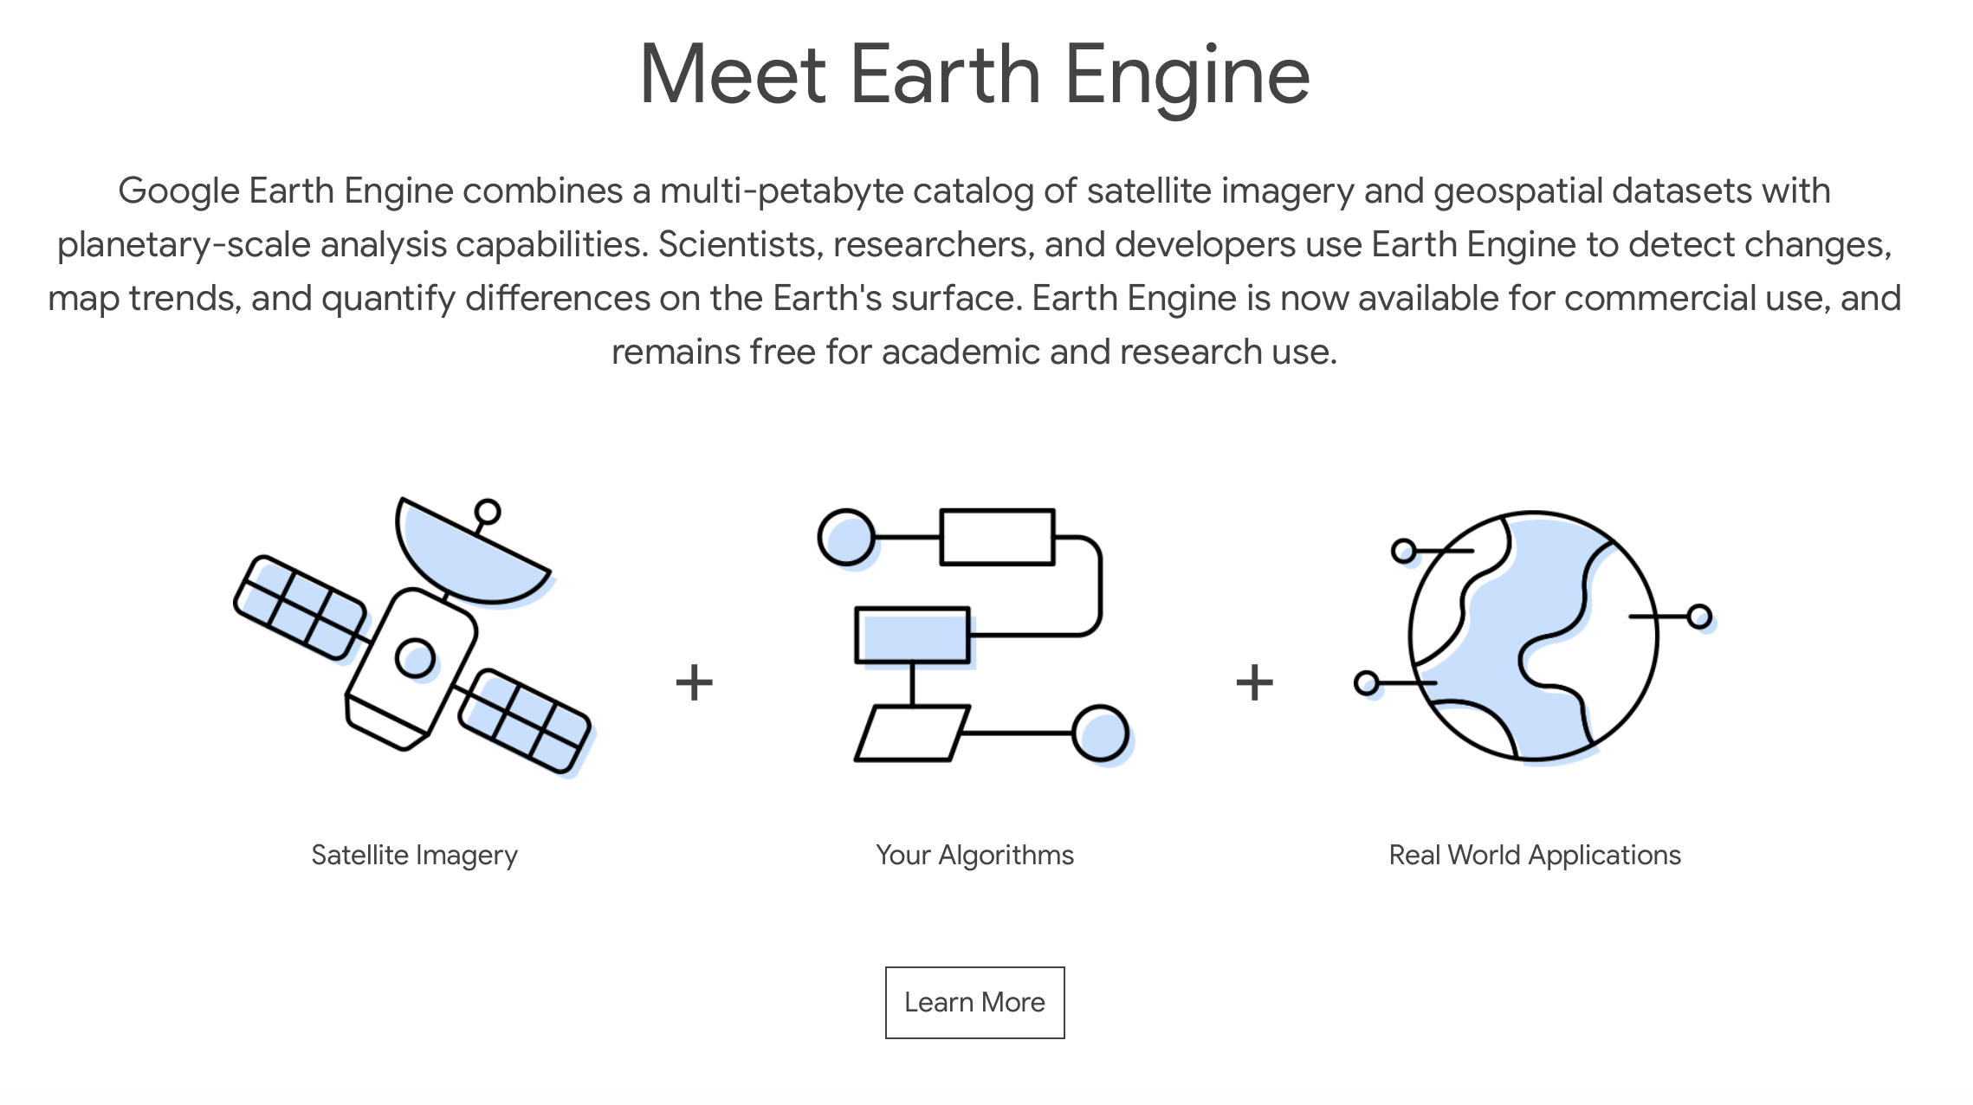
4. Google Earth Engine (GEE)
Google Earth Engine is one of the most exciting developments in modern GIS!
Open-source tool aimed at academic/research community
Used distributed processing to make large operations incredibly fast and efficient
Supports cloud storage, Git, and open-source user development
Setting it up
Applying for Access
Platform
Configuring Python/QGIS
Example in Chrome
Cumulative global rainfall, 2017
Example in QGIS
SRTM 30m resolution

Slide 13
Wrapping Up Our Workshop

Slide 14
Course Stats
400+ Registrants; 50-120 attendees live per week
Attendees represent over 29 countries across 6 continents!
~ 70 pages of guide material – over 20,000 words of text!
8 hours of live lectures; 3.5 hours of supplementary lectures
> 1 GB of course data

Slide 15
My goals at the start:
Highlight what GIS can do for geoscientists
Outline the key principles of a geographic information system
Providing a fully guided GIS workflow template
Identify key areas of growth for GIS in geoscience research

Slide 16
If you take nothing else away from this workshop….
GIS is a helpful tool in your workflow if you have data with a spatial dimension
GIS software lets you store, collect, analyze, and share spatial data
Modern GIS platforms like ArcMap and QGIS are all around workhorses – essential to tasks like spatial modeling, database management, cartography, geodesy, data visualization, hazard mitigation, and story telling
Learning the capabilities of GIS is acquired from repeated, often frustrating, trial and error with the hundreds of built-in tools
Studies should be designed with the GIS end user in mind!!!

Slide 17
Further Learning
We have only scratched the surface!
Best way to learn QGIS:
Find a project that you are interested in, and that requires QGIS
Use the forums: StackExchange, Documentation, GitHub
Take a break if you are feeling discouraged
Seek out external learning opportunities
Free resources online

Slide 18
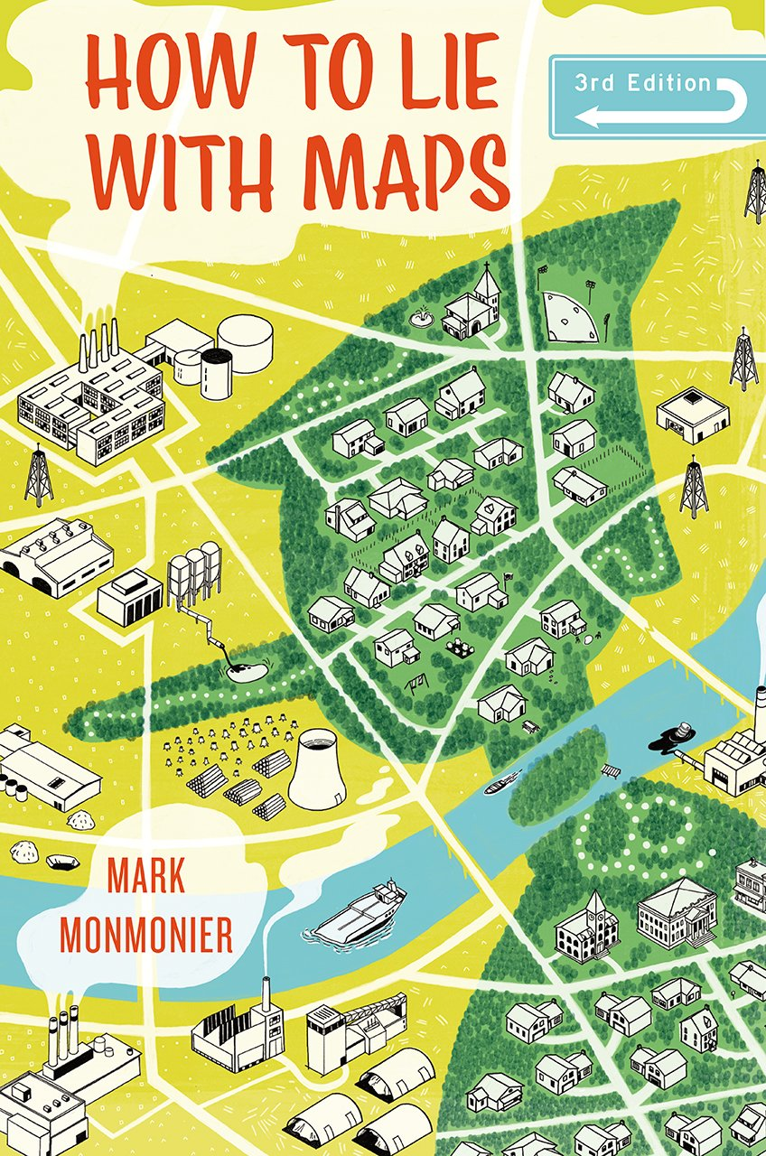
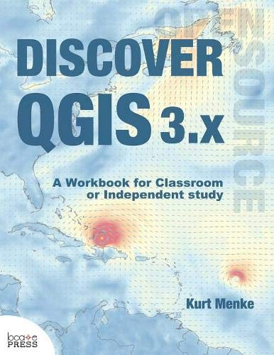
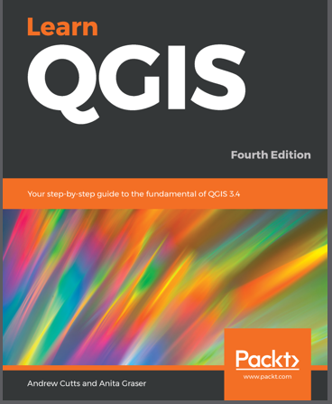
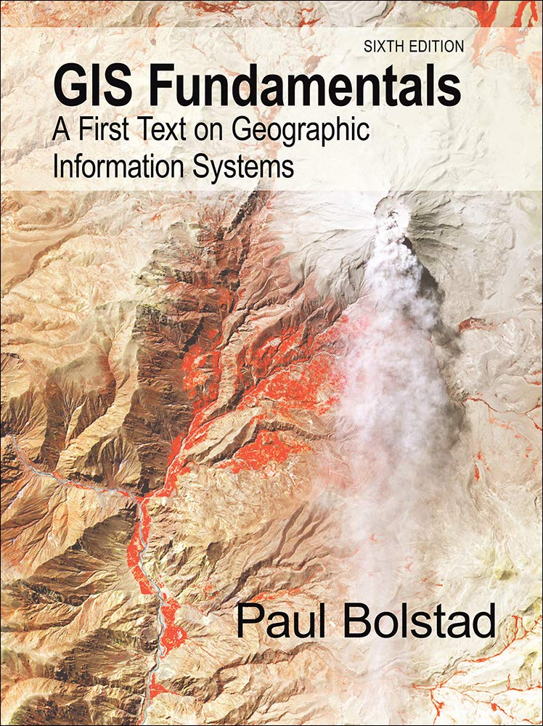
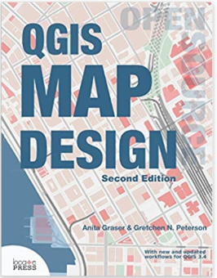
Textbooks
Geospatial Analysis, de Smith (2020): https://www.spatialanalysisonline.com/HTML/index.html
Principles of Geographic Information Systems, Huisman & de By: https://webapps.itc.utwente.nl/librarywww/papers_2009/general/principlesgis.pdf

Slide 19
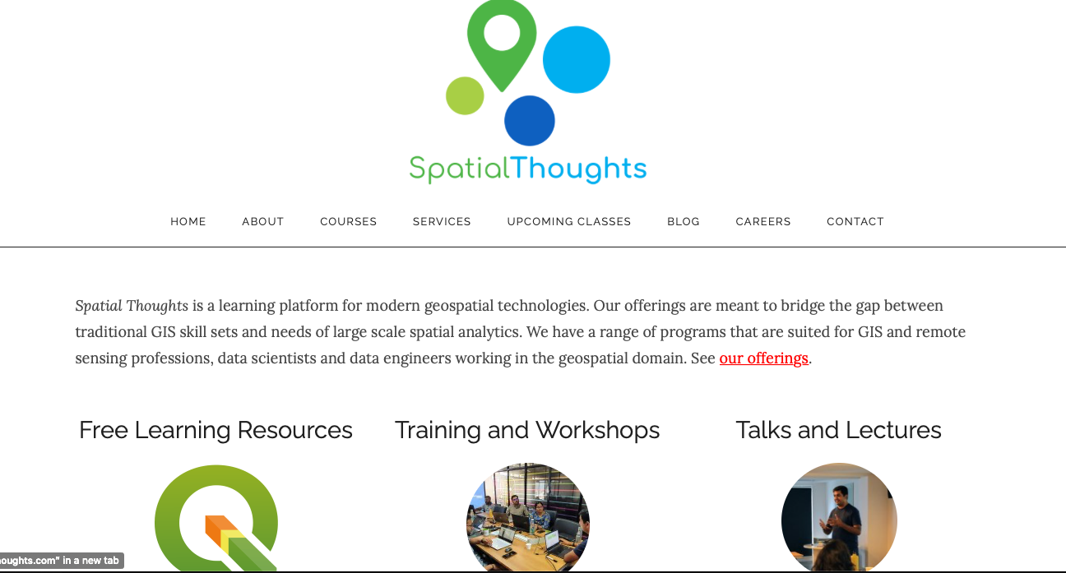

Slide 20



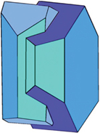

Acknowledgements
Thank you to McGill University (Cat Crotty), University College London (Emma Liu), and the Volcano Magmatic Studies Group (Claire Harnett and Emma Watts) for helping to shape the course, and for providing a platform where I can share my love of GIS with you!

Slide 21
Thank You ☺ Happy GIS-ing!

